Slide 1

DATA ANALYTICS
UNIT-2
SAMPLING
Data Analytics-Sampling
UNIT-II
Department of CSE, School of Engineering, Malla Reddy University,Hyderabad
Notes:
You can safely remove this slide. This slide design was provided by SlideModel.com – You can download more templates, shapes and elements for PowerPoint from http://slidemodel.com

Slide 2

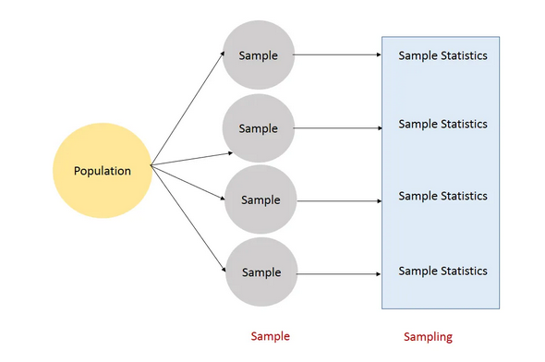
Sampling, Sample Statistics:
We have a population of x values and Select a sample of size n from this population and calculate a sample statistic e.g. x̅ (mean).
01
08
Middle Level
Language
02
Memory
Management
Structured
Language
03
Speed
07
Rich Library
04
Pointers
Extensible
Recursion
05
Data Analytics-Sampling
UNIT-II
Department of CSE, School of Engineering, Malla Reddy University,Hyderabad

Slide 3
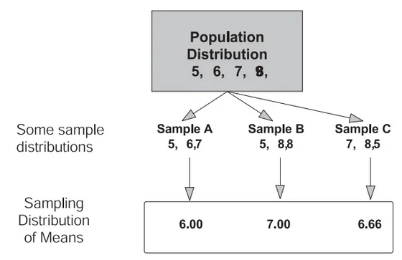
Sampling Distributions :
The distribution of sample statistics is called “Sampling Distribution”.
For example, a sample of size three (N=3) is taken from some population (5, 6, 7, and 8) . The mean of the three numbers is computed. Next a new sample of three is taken, and the mean is again computed. If this process were repeated an infinite number of times, the distribution of the now infinite number of sample means would be called the sampling distribution of the mean.
Consider the below diagram to get more clarification about sampling distribution.
01
08
Middle Level
Language
02
Memory
Management
Structured
Language
03
Speed
07
Rich Library
04
Pointers
Extensible
Recursion
05
Data Analytics-Sampling
UNIT-II
Department of CSE, School of Engineering, Malla Reddy University,Hyderabad

Slide 4
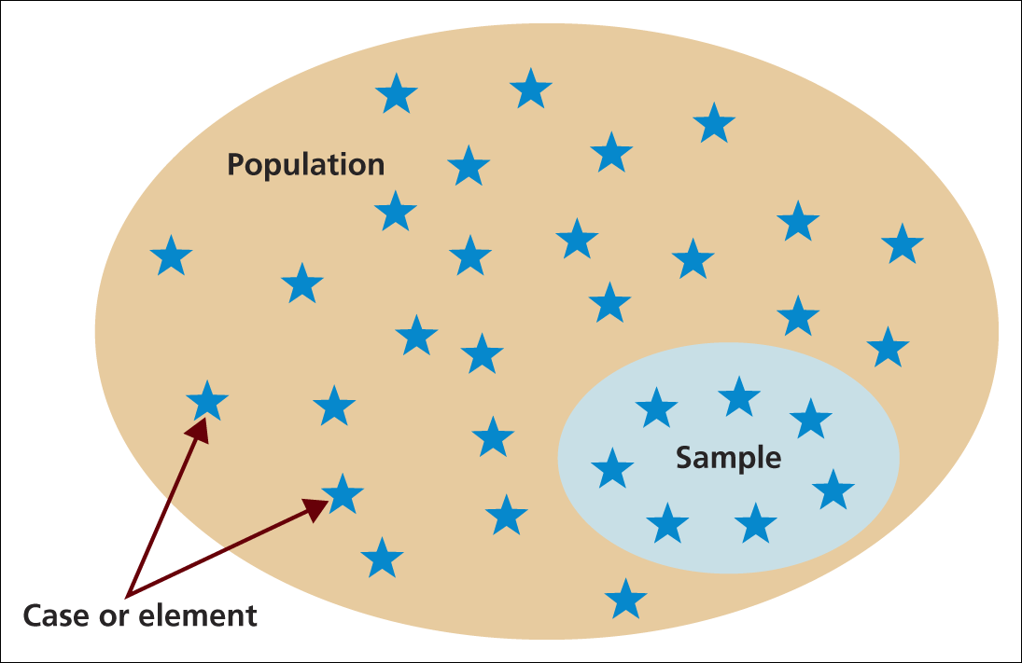
Sampling methods :
The process of selecting just a small group of cases from out of a large group is called sampling.
A survey of the entire population is impracticable
Budget constraints restrict data collection
Time constraints restrict data collection
Results from data collection are needed quickly
01
08
Middle Level
Language
02
Speed
Memory
Management
Structured
Language
03
07
Rich Library
04
Pointers
Extensible
Recursion
05
Data Analytics-Sampling
UNIT-II
Department of CSE, School of Engineering, Malla Reddy University,Hyderabad

Slide 5
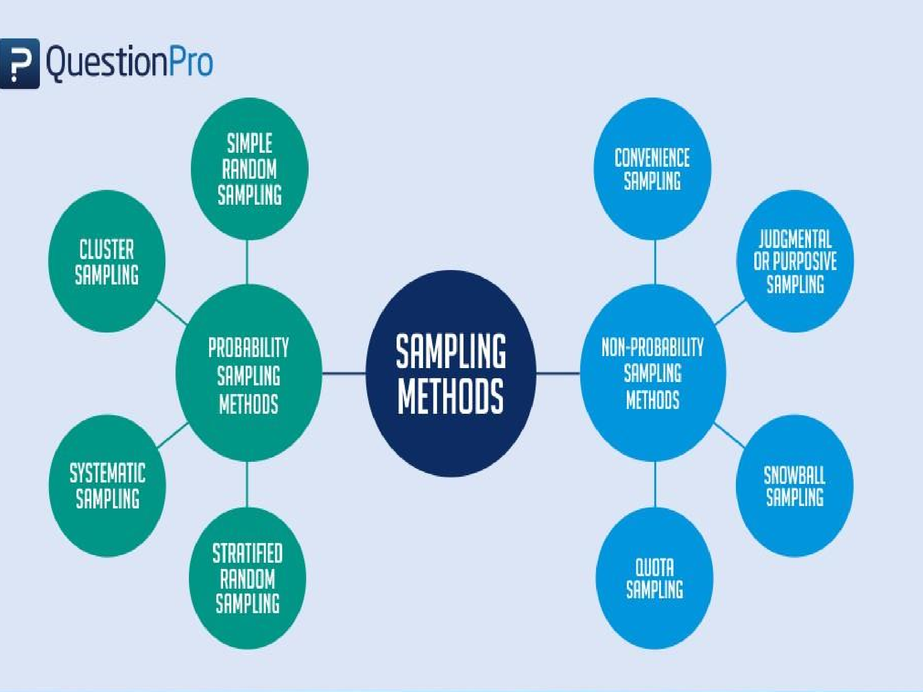
Sampling methods :
01
08
Middle Level
Language
02
Speed
Memory
Management
Structured
Language
03
07
Rich Library
04
Pointers
Extensible
Recursion
05
Data Analytics-Sampling
UNIT-II
Department of CSE, School of Engineering, Malla Reddy University,Hyderabad

Slide 6
Sampling methods :
Probability sampling techniques give the most reliable representation of the
whole population.
2. Non-probability sampling techniques not give the most reliable representation
of the whole population.
Four main methods used for a probability sample such as
1. Simple random sampling method
2. Stratified random sampling method
3. Cluster sampling method
4. Systematic sampling method
01
08
Middle Level
Language
02
Speed
Memory
Management
Structured
Language
03
07
Rich Library
04
Pointers
Extensible
05
Data Analytics-Sampling
UNIT-II
Department of CSE, School of Engineering, Malla Reddy University,Hyderabad

Slide 7

1. Simple random sampling method :
As the name suggests is a completely random method of selecting the sample. This sampling method is as easy as assigning numbers to the individuals (sample) and then randomly choosing from those numbers through an automated process
01
08
Middle Level
Language
02
Speed
Memory
Management
Structured
Language
03
07
Rich Library
04
Pointers
Extensible
Recursion
05
Data Analytics-Sampling
UNIT-II
Department of CSE, School of Engineering, Malla Reddy University,Hyderabad

Slide 8

2. Stratified random sampling method :
It involves a method where a larger population can be divided into smaller groups (known as strata) based on sex, age etc.
01
08
Middle Level
Language
02
Speed
Memory
Management
Structured
Language
03
07
Rich Library
04
Pointers
Extensible
Recursion
05
Data Analytics-Sampling
UNIT-II
Department of CSE, School of Engineering, Malla Reddy University,Hyderabad

Slide 9
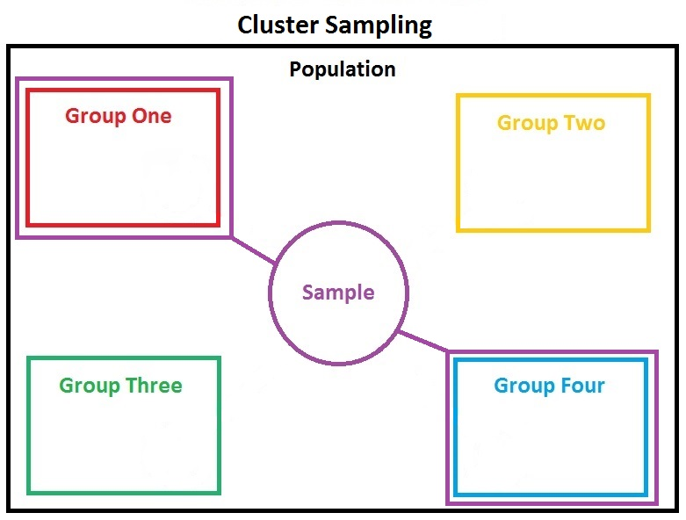
3. Cluster sampling method :
In this method, you divide a population into clusters, such as districts, city or schools, etc and then randomly select some of these clusters as your sample.
01
08
Middle Level
Language
02
Speed
Memory
Management
Structured
Language
03
07
Rich Library
04
Pointers
Extensible
Recursion
05
Data Analytics-Sampling
UNIT-II
Department of CSE, School of Engineering, Malla Reddy University,Hyderabad

Slide 10
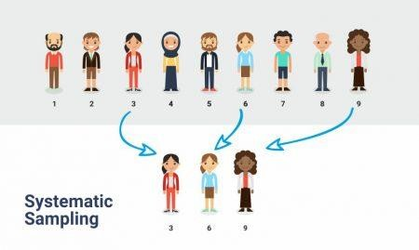
4. Systematic sampling method:
In this method, you select nth individual from a entire population. So every “nth” individual to be a part of the sample. For example, you can choose every 3rd person to be in the sample.
01
08
Middle Level
Language
02
Speed
Memory
Management
Structured
Language
03
07
Rich Library
04
Pointers
Extensible
Recursion
05
Data Analytics-Sampling
UNIT-II
Department of CSE, School of Engineering, Malla Reddy University,Hyderabad

Slide 11
Types of Non-probability Sampling methods:
1. Convenience sampling method
2. Judgmental sampling method
3. Snowball sampling method
4. Quota sampling method
01
08
Middle Level
Language
02
Speed
Memory
Management
Structured
Language
03
07
Rich Library
04
Pointers
Extensible
Recursion
05
Data Analytics-Sampling
UNIT-II
Department of CSE, School of Engineering, Malla Reddy University,Hyderabad

Slide 12

1. Convenience sampling method :
Convenience sampling is the most common sampling, mostly because it is misused. Convenience sampling is a method of collecting samples by taking samples that are conveniently located around a location or Internet service.
For example: person interviewed at random in a shopping center for a television program.
01
08
Middle Level
Language
Speed
Memory
Management
Structured
Language
03
07
Rich Library
04
Pointers
Extensible
Recursion
05
Data Analytics-Sampling
UNIT-II
Department of CSE, School of Engineering, Malla Reddy University,Hyderabad

Slide 13

2. Judgmental sampling method :
In this method, the sample members are chosen only on the basis of the researcher’s knowledge and judgment.
01
08
Middle Level
Language
Speed
Memory
Management
Structured
Language
03
07
Rich Library
04
Pointers
Extensible
Recursion
05
Data Analytics-Sampling
UNIT-II
Department of CSE, School of Engineering, Malla Reddy University,Hyderabad

Slide 14
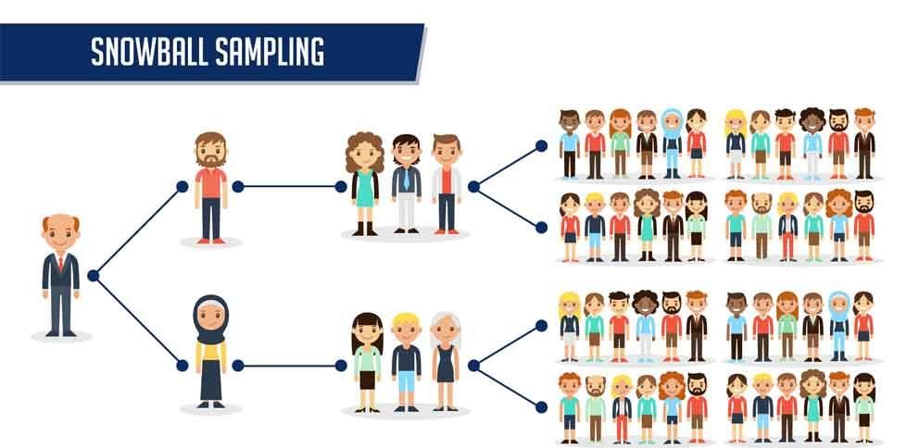
3. Snowball sampling method :
Snowball sampling method is purely based on referrals and that is how a researcher is able to generate a sample. Therefore this method is also called the chain-referral sampling method.
01
08
Middle Level
Language
Speed
Memory
Management
Structured
Language
03
07
Rich Library
04
Pointers
Extensible
Recursion
05
Data Analytics-Sampling
UNIT-II
Department of CSE, School of Engineering, Malla Reddy University,Hyderabad

Slide 15
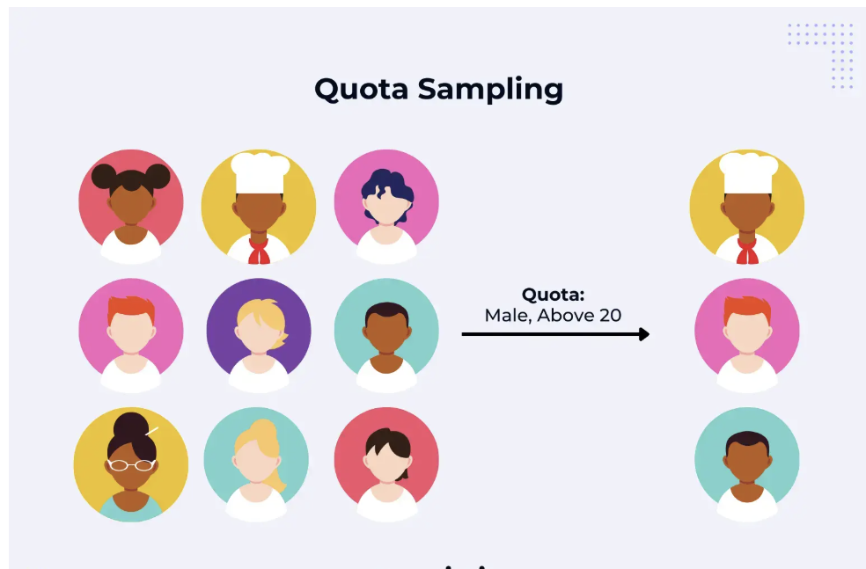
4. Quota sampling method :
Selection of members in this sampling technique happens on basis of a pre-set standard. In this case, as a sample is formed on basis of specific attributes, the created sample will have the same attributes that are found in the total population. It is an extremely quick method of collecting samples.
01
08
Middle Level
Language
Speed
Memory
Management
Structured
Language
03
07
Rich Library
04
Pointers
Extensible
Recursion
05
Data Analytics-Sampling
UNIT-II
Department of CSE, School of Engineering, Malla Reddy University,Hyderabad

Slide 16

www.mallareddyuniversity.com
Notes:
You can safely remove this slide. This slide design was provided by SlideModel.com – You can download more templates, shapes and elements for PowerPoint from http://slidemodel.com

